Slide 1
MODEL – VIEW - CONTROL
CIT 360 GROUP 4 EDGAR ROMERO

Slide 2
CODING TOPIC INTRODUCTION
Everybody has a different idea of exactly what MVC is and what code falls into which part. Is it Model, View, or Control code?
Ask that question in a design meeting and you almost always get multiple answers from experienced software engineers. That’s because the answer depends on opinion, not fact. So in this book I’m going to suggest a definition for us to use.
References
Doing more with Java, page 71
Model - View - Controller:
https://www.youtube.com/watch?v=dTVVa2gfht8
https://www.youtube.com/watch?v=pCvZtjoRq1I

Slide 3
Summary of MODEL-VIEW-CONTROLLER
MODEL
It is the Data Related Logic and establish the interaction with database as SELECT, INSERT, UPDATE, DELETE. Model communicates with controller and, depending on the framework it can update the VIEW.
VIEW
This is the interaction with the end user, it is what they see on the screen. Usually consist of HTML and CSS, communicates with the CONTROLLER.
CONTROLLER
This is where we received the input, in this step we get the data from MODEL and transmit the data to VIEW. Processes requested: GET, POST, PUT, DELETE.
So, what is MVC?
MVC, stands for MODEL-VIEW-CONTROLER
It is a Software Architectural Design Pattern
This is one of the most frequently used patterns
It helps to separate application functionality
Help us to keep the programming code organized
Diagram 1: the application controller pattern as a class diagram

Slide 4
Application MODEL-VIEW-CONTROLLER
Let’s define Model first. It seems to be the easiest for people to agree on. How about “The model is the data, a representation of the data, and code that hides how the data is accessed and stored.”
The definition of View code we’ll use is “Any code that is used to communicate with the user OR ANY OTHER COMPUTING SYSTEM requesting or sending data ( this is IO code not part of the model).” Lots of people new to software development seem to get the idea that View code only consists of what the user sees. OK.
What is a user? Does a user have to be human? Nope. That leaves us needing a definition for Control. Here is one I like. “Control code is the smarts of the application. If a decision is being made, it’s Control code. If data is being manipulated, stats calculated, strings assembled, etc., its Control code.”

Slide 5
SAMPLE CODE FOR MODEL
// The Model performs all the calculations needed and that is it. It doesn't know the View exist
public class CalculatorModel {
// Holds the value of the sum of the numbers
// entered in the view
private int calculationValue;
public void addTwoNumbers(int firstNumber, int secondNumber){
calculationValue = firstNumber + secondNumber; }
public int getCalculationValue(){
return calculationValue;
} }

Slide 6
SAMPLE CODE FOR VIEW
// This is the View Its only job is to display what the user sees It performs no //calculations, but instead passes // information entered by the user to whomever needs // it.
import java.awt.event.ActionListener;
import javax.swing.*;
public class CalculatorView extends JFrame{
private JTextField firstNumber = new JTextField(10);
private JLabel additionLabel = new JLabel("+");
private JTextField secondNumber = new JTextField(10);
private JButton calculateButton = new JButton("Calculate");
private JTextField calcSolution = new JTextField(10);
CalculatorView(){
// Sets up the view and adds the components
JPanel calcPanel = new JPanel();
this.setDefaultCloseOperation(JFrame.EXIT_ON_CLOSE);
this.setSize(600, 200);
calcPanel.add(firstNumber);
calcPanel.add(additionLabel);
calcPanel.add(secondNumber);
calcPanel.add(calculateButton);
calcPanel.add(calcSolution);
this.add(calcPanel);
// continue on the right…
// continuation…
// End of setting up the components --------
} public int getFirstNumber(){
return Integer.parseInt(firstNumber.getText()); }
public int getSecondNumber(){
return Integer.parseInt(secondNumber.getText()); }
public int getCalcSolution(){
return Integer.parseInt(calcSolution.getText()); }
public void setCalcSolution(int solution){ calcSolution.setText(Integer.toString(solution)); }
// If the calculateButton is clicked execute a method
// in the Controller named actionPerformed
void addCalculateListener(ActionListener listenForCalcButton){ calculateButton.addActionListener(listenForCalcButton); }
// Open a popup that contains the error message passed
void displayErrorMessage(String errorMessage){ JOptionPane.showMessageDialog(this, errorMessage); } }
Diagram 1: the application controller pattern as a class diagram

Slide 7
SAMPLE CODE FOR CONTROLLER
import java.awt.event.ActionEvent;
import java.awt.event.ActionListener;
// The Controller coordinates interactions
// between the View and Model
public class CalculatorController {
private CalculatorView theView;
private CalculatorModel theModel;
public CalculatorController(CalculatorView theView,
CalculatorModel theModel) {
this.theView = theView; this.theModel = theModel;
// Tell the View that when ever the calculate button
// is clicked to execute the actionPerformed method
// in the CalculateListener inner class
this.theView.addCalculateListener(new CalculateListener()); } class CalculateListener implements ActionListener{
public void actionPerformed(ActionEvent e) {
int firstNumber, secondNumber = 0;
// continue to the right…
// continuation…
// Surround interactions with the view with
// a try block in case numbers weren’t
// properly entered
try{
firstNumber = theView.getFirstNumber();
secondNumber = theView.getSecondNumber();
theModel.addTwoNumbers(firstNumber, secondNumber); theView.setCalcSolution(theModel.getCalculationValue()); }
catch(NumberFormatException ex){
System.out.println(ex); theView.displayErrorMessage("You Need to Enter 2 Integers");
} } } }
Diagram 1: the application controller pattern as a class diagram

Slide 8
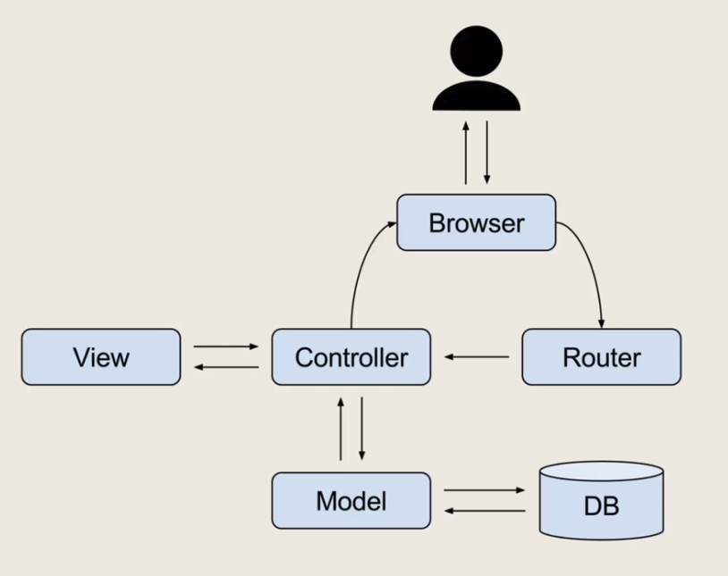
Application Controller Pattern
To understand the Model View Controller you just need to know that it separates the Calculations and Data from the interface. The Model is the class that contains the data and the methods needed to use the data. The View is the interface. The Controller coordinates interactions between the Model and View.
The code in the previous slides will make it easier to understand.

